Slide 1
Linear Regression

Slide 2
Correlation and Prediction
In the previous lesson, we learned to measure the strength of the linear relationship between two variables with the correlation coefficient r.
When there is a strong linear relationship two variables, we can use the value of the predictor variable to estimate the value of the response variable.

Slide 3
A Motivating Example
A person takes in more oxygen when exercising than when at rest. The oxygen is supplied to the muscles by the heart, which must beat faster as the exercise level is increased.
Suppose that we wish to determine the oxygen uptake of subjects at various levels of activity.
Measuring oxygen uptake directly requires the use of specialized and costly equipment in a lab environment.
Measuring a person’s heart rate is simple, inexpensive, and convenient.
If a person’s oxygen uptake can be predicted accurately from the heart rate, we may be able to use the predicted uptake values instead of direct measurements for our research purposes.

Slide 4
Oxygen Uptake Data
Time
HR
VO₂
Suppose the heart rate (HR) and oxygen uptake (VO₂) for a subject exercising on a treadmill were recorded during a 20-minute workout, and the following data were recorded:
1
96
.753
2
95
.929
3
95
.939
4
94
.832
5
95
.983
6
94
1.049
The correlation coefficient,
7
104
1.178
8
104
1.176
r = .986
9
106
1.292
10
109
1.379
indicates a strong, positive, linear relationship between heart rate and oxygen uptake.
11
108
1.403
12
110
1.499
13
113
1.529
14
113
1.599
15
118
1.749
16
115
1.746
17
121
1.897
18
127
2.040
19
131
2.231
20
130
2.301

Slide 5
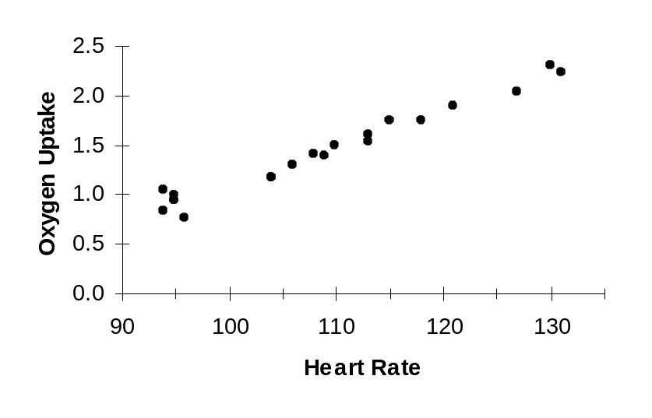
Scatter Plot
From the scatter plot, observe:
the trend in the data–the oxygen uptake increases as the heart rate increases.
the sample points do not fall on a single line, but they do appear to be scattered about a central line, the line of best fit.
Scatter plot of oxygen uptake vs. heart rate data
We can use the line of best fit to estimate the oxygen uptake from the measured heart rate.
For example, at a heart rate of 100 beats per minute, the predicted oxygen uptake is approximately 1.1 (units?)

Slide 6
Example 1: Fitting a Line to a Bivariate Data Set
For the following data set:
x
3
4
5
7
8
(a) Draw a scatter diagram treating x as the predictor variable and y as the response variable.
y
4
5
7
15
14
15
10
y
5
0
2
4
6
8
x

Slide 7
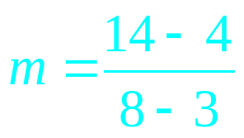
Example 1: Fitting a Line to a Bivariate Data Set
For the following data set:
x
3
4
5
7
8
(b) Select two points from the scatter diagram and find an equation of the line (in the form y = mx + b) containing the points.
y
4
5
7
15
14
15
y = 2x – 2
(8, 14)
10
y
5
Take the points (3, 4) and
(8, 14).
(3, 4)
0
2
4
6
8
The slope is:
= 2
x
Substitute m = 2, x = 3, and y = 4 to obtain the y-intercept:
4 = (2)(3) + b
⇒ 4 = 6 + b
⇒ b = –2
⇒ y = 2x – 2

Slide 8
Errors and Residuals
A predicted value of y is denoted with the symbol ŷ (“y-hat”).
The difference between the actual value of y and the predicted value of y is the error or residual. That is
error = observed y value – predicted y value
= y – ŷ
For any predicted value ŷ, the squared error is (y – ŷ)²
For any given line of fit, the sum of the squared errors is
SSE = Σ(y – ŷ)²
The least squares regression line is the line of fit that minimizes the sum of the squared errors.

Slide 9
Example 2: Fitting a Line to a Bivariate Data Set
For the following data set:
x
3
4
5
7
8
(c) Compute the sum of the squared errors for the line
ŷ = 2x – 2 .
y
4
5
7
15
14
ŷ
4
6
8
12
14
y – ŷ
0
–1
–1
3
0
(y – ŷ)²
0
1
1
9
0
15
SSE = Σ(y – ŷ)² = 11
ŷ = 2x – 2
(8, 14)
10
y
5
(3, 4)
0
2
4
6
8
x

Slide 10
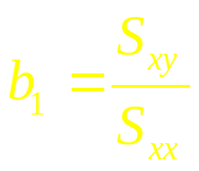

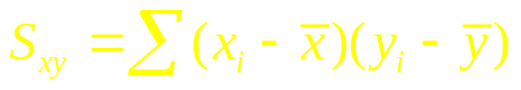
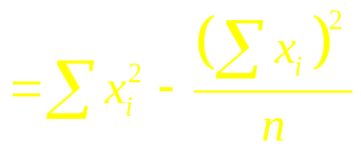
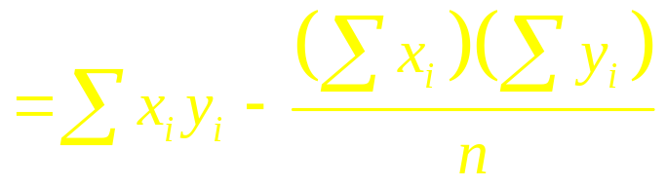
Equation of the Least Squares Regression Line
The equation of the least-squares regression line is given by
ŷ = b₁x + b₀
where
the slope of the least-squares line is
Recall

Slide 11

Equation of the Least Squares Regression Line
The equation of the least-squares regression line is given by
ŷ = b₁x + b₀
where
the intercept of the least-squares line is
Note: The value ŷ predicts the mean value of the response variable y at the for a specific value of x.
The graph of the least-squares equation is also known as the line of means of the data.

Slide 12
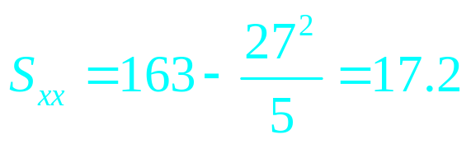
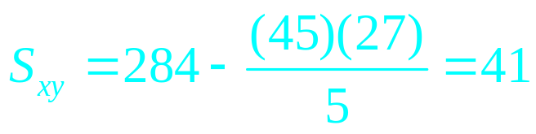
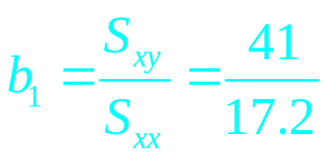

Example 3: Finding the Least Squares Regression Line
For the following data set:
x
3
4
5
7
8
(d) Find the equation of the least squares regression line.
y
4
5
7
15
14
x²
9
16
25
49
64
xy
12
20
35
105
112
Σx = 27 Σy = 45 x = 5.4 y = 9
Σx² = 163
Σxy = 284
The slope of the least-squares line is
= 2.38
The intercept of the least-squares line is
= 9 – (2.38)(5.4) = –3.85
Thus, ŷ = 2.38x – 3.85

Slide 13
Example 3: Finding the Least Squares Regression Line
For the following data set:
x
3
4
5
7
8
(e) Graph the least squares regression line on the scatter diagram.
y
4
5
7
15
14
15
ŷ = 2.38x – 3.85
10
y
5
0
2
4
6
8
x

Slide 14
Example 3: Finding the Least Squares Regression Line
For the following data set:
x
3
4
5
7
8
(e) Graph the least squares regression line on the scatter diagram.
y
4
5
7
15
14
ŷ
3.3
5.7
8.1
12.8
15.2
y – ŷ
.7
–.7
–1.1
2.2
–1.2
(y – ŷ)²
.49
.49
1.21
4.84
1.44
15
ŷ = 2.38x – 3.85
(f) Compute the sum of the squared errors for the regression line.
10
y
5
SSE = Σ(y – ŷ)² = 8.47
0
2
4
6
8
Note that this SSE is lower than the first line, i.e. the “fit” is best for the least squares line.
x

Slide 15
INTERPRETATION OF THE SLOPE (m or b1)
FOR EVERY ONE UNIT INCREASED IN THE INDEPENDENT VARIABLE, THE DEPENDENT VARIABLE IS INCREASED OR DECREASED BY AN AVERAGE OF THE VALUE OF THE SLOPE.
INTERPRETATION OF THE y-INTERCEPT (b or bo)
THE VALUE OF THE DEPENDENT VARIABLE (y) WHEN THE INDEPENDENT VARIABLE (X) IS 0.

Slide 16
THE COEFFICIENT OF DETERMINATION (R²)
- VARIANCE EXPLAINED BY THE INDEPENDENT VARIABLE FOR THE DEPENDENT VARIABLE
- THE MODEL FIT ((R²)
THE COEFFICIENT OF ALIENATION (1 – r² )
- PERCENTAGE/VARIANCE NOT EXPLAINED BY THE INDEPENDENT VARIABLE FOR THE DEPENDENT VARIABLE.

Slide 17
Example 4: Weight vs. Mileage Rating
The data represent the weight of various domestic cars and their city mileage rating (in mpg) for the 2001 model year.
Weight (pounds)
Miles Per Gallon
3565
19
3440
20
(a) Find the least squares regression line treating weight as the predictor variable (x) and mileage as the response variable (y).
3970
17
3305
19
3340
20
3200
20
3230
19
Using SPSS, the equation of the least-squares line is:
2560
28
2520
28
3065
20
ŷ = –.0073x + 44.3
3600
18
3300
19
3625
19
3590
19
2605
23
2370
28

Slide 18
Example 4: Weight vs. Mileage Rating
The data represent the weight of various domestic cars and their city mileage rating (in mpg) for the 2001 model year.
Weight (pounds)
Miles Per Gallon
3565
19
3440
20
(b) Interpret the slope and intercept, if possible.
3970
17
3305
19
The slope m = –0.0073 means that the mileage is reduced by an average of 0.0073 mpg for a one pound increase in the weight of the car.
3340
20
3200
20
3230
19
2560
28
2520
28
3065
20
Since a weight of x = 0 lbs is not possible, there is no meaningful interpretation of the intercept.
3600
18
3300
19
3625
19
3590
19
2605
23
2370
28

Slide 19
Example 4: Weight vs. Mileage Rating
The data represent the weight of various domestic cars and their city mileage rating (in mpg) for the 2001 model year.
Weight (pounds)
Miles Per Gallon
3565
19
3440
20
(c) Predict the mileage of an Oldsmobile Aurora (3625 lbs) and compute the residual error.
3970
17
3305
19
3340
20
3200
20
The predicted mileage is
3230
19
ŷ = –.0073(3625) + 44.3
= 18 mpg
2560
28
2520
28
The residual error is +1 mpg
3065
20
3600
18
Is the mileage of an Aurora above or below average for cars of this weight?
3300
19
3625
19
3590
19
Since the residual is positive, the Aurora is above average for cars of its weight.
2605
23
2370
28

Slide 20
Example 4: Weight vs. Mileage Rating
The data represent the weight of various domestic cars and their city mileage rating (in mpg) for the 2001 model year.
Weight (pounds)
Miles Per Gallon
3565
19
3440
20
(d) Draw the least-squares regression line on the scatter diagram of the data and label the residual.
3970
17
3305
19
3340
20
3200
20
3230
19
Weight vs. Mileage
2560
28
30
2520
28
3065
20
City Mileage (MPG)
3600
18
25
3300
19
20
Residual
3625
19
15
3590
19
2000
2500
3000
3500
4000
2605
23
Weight (lbs)
2370
28

Slide 21
Example 4: Weight vs. Mileage Rating
The data represent the weight of various domestic cars and their city mileage rating (in mpg) for the 2001 model year.
Weight (pounds)
Miles Per Gallon
3565
19
3440
20
(e) Would it be reasonable to use the least-squares regression line to predict the mileage of a Honda Insight—a hybrid gas and electric car? Why?
3970
17
3305
19
3340
20
3200
20
3230
19
2560
28
No. Since the hybrid uses a different fuel source, we cannot expect its mileage to be predicted by this model.
2520
28
3065
20
3600
18
3300
19
3625
19
3590
19
2605
23
2370
28

Slide 22
Example 4: Weight vs. Mileage Rating
The data represent the weight of various domestic cars and their city mileage rating (in mpg) for the 2001 model year.
Weight (pounds)
Miles Per Gallon
3565
19
3440
20
(f) Compute for the model fit or the coefficient of determination (R²), and interpret.
3970
17
3305
19
3340
20
3200
20
3230
19
R² = (-0.92)^2 = 85%, this means that 85% of the variance in the mileage of the car can be explained by the variance of its weight. Or the weight of the car contributed 85% of its mileage.
15% is the coefficient of alienation.
2560
28
2520
28
3065
20
3600
18
3300
19
3625
19
3590
19
2605
23
2370
28

Slide 23
Limitations of the Regression Model
If the least-squares regression line is used to make predictions based on values of the predictor variable that are much larger or smaller than the observed values, we say the researcher is working outside the scope of the model.
Never use a least-squares regression line to make predictions outside the scope of the model because we can’t be sure the linear relation continues to exist.
If the correlation coefficient is near zero, indicating a weak or non-existent linear relationship between the variables, use the mean value of the response variable as the predicted value.

Slide 24
Example 5: Brain Size and Intelligence
Researchers interested in whether a person’s brain size is related to mental capacity selected a sample of 20 students who had SAT scores higher than 1350 and administered an IQ test. Brain size was determined by an MRI scan.
(a) Find the least-squares regression line treating MRI count as the predictor variable and IQ as the response variable.
Gender
MRI Count
IQ
Gender
MRI Count
IQ
Female
816932
133
Male
949395
140
Female
951545
137
Male
1001121
140
Female
991305
138
Male
1038437
139
Female
833868
132
Male
965353
133
Female
856472
140
Male
955466
133
Female
852244
132
Male
1079549
141
ŷ = 0.000029x + 110
Female
790619
135
Male
924059
135
Female
866662
130
Male
955003
139
Female
857782
133
Male
935494
141
Female
948066
133
Male
949589
144

Slide 25
Example 5: Brain Size and Intelligence
Researchers interested in whether a person’s brain size is related to mental capacity selected a sample of 20 students who had SAT scores higher than 1350 and administered an IQ test. Brain size was determined by an MRI scan.
(b) What do you notice about the value of the slope?
Gender
MRI Count
IQ
Gender
MRI Count
IQ
Female
816932
133
Male
949395
140
Female
951545
137
Male
1001121
140
The slope is near zero.
Female
991305
138
Male
1038437
139
Female
833868
132
Male
965353
133
Why does this result seem reasonable based on the correlation coefficient calculated earlier.
Female
856472
140
Male
955466
133
Female
852244
132
Male
1079549
141
Female
790619
135
Male
924059
135
Female
866662
130
Male
955003
139
Female
857782
133
Male
935494
141
Female
948066
133
Male
949589
144

Slide 26

Example 5: Brain Size and Intelligence
Researchers interested in whether a person’s brain size is related to mental capacity selected a sample of 20 students who had SAT scores higher than 1350 and administered an IQ test. Brain size was determined by an MRI scan.
(c) When there is no relation between the predictor and response variables, we use the mean value y to predict.
Gender
MRI Count
IQ
Gender
MRI Count
IQ
Brain Size vs Intelligence
145
Female
816932
133
Male
949395
140
140
Female
951545
137
Male
1001121
140
IQ
135
Female
991305
138
Male
1038437
139
130
Female
833868
132
Male
965353
133
125
Female
856472
140
Male
955466
133
Predict the IQ of an individual whose MRI count is 1,000,000.
Female
800
900
1000
1100
852244
132
Male
1079549
141
Female
790619
135
MRI Count
×1000
Male
924059
135
y = 136
Female
866662
130
Male
955003
139
Female
857782
133
Male
935494
141
Female
948066
133
Male
949589
144

Slide 27
